Slide 1
Hard Platformer

Slide 2
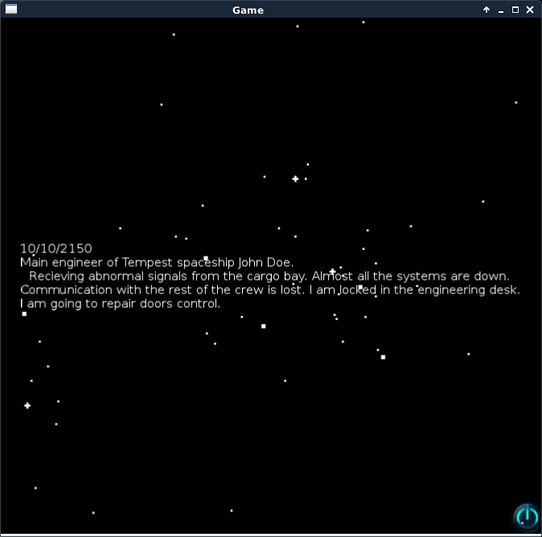
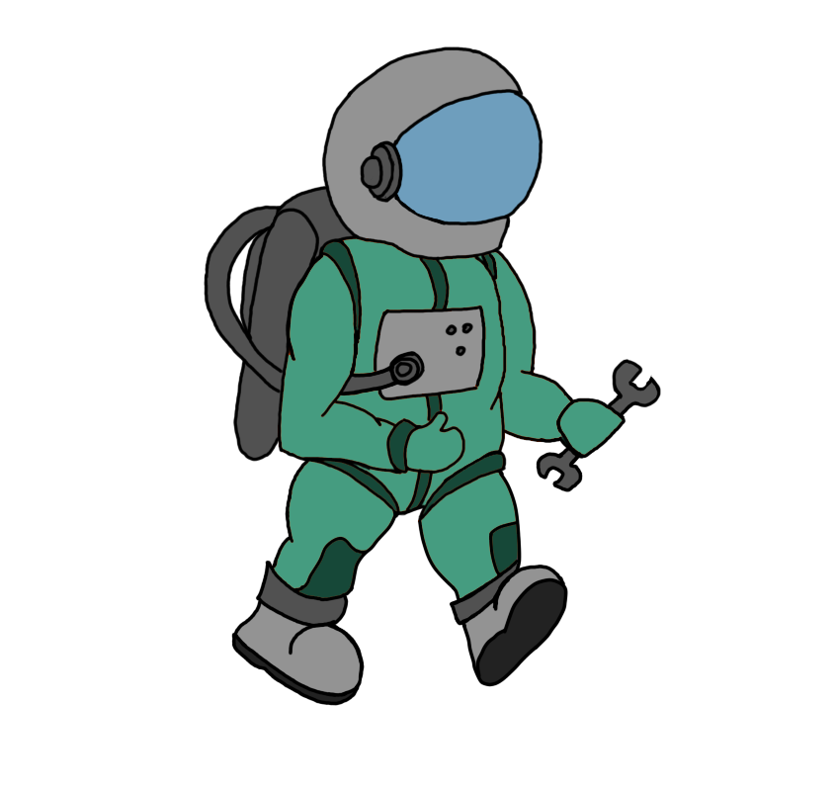


Slide 4
Scene
Level
LevelCompleteScene
Menu
Administrator

Slide 5
Player:
Jet energy
Live
Goals
Items
Sprite
Player1

Slide 6
Спасибо за внимание!

